Slide 1

Wiki Gaming
Week 2
The Larger Group
Intro
1
Catalog
2 3
User Forms
4
Accounts
5
Voting
6
Marketing
7
Overall
8

Slide 2
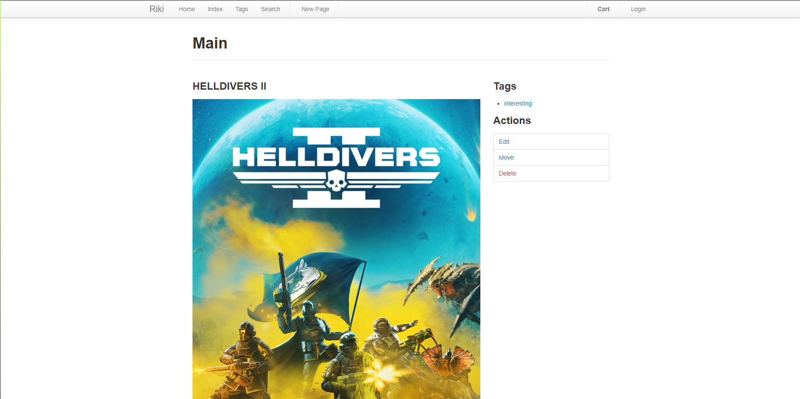
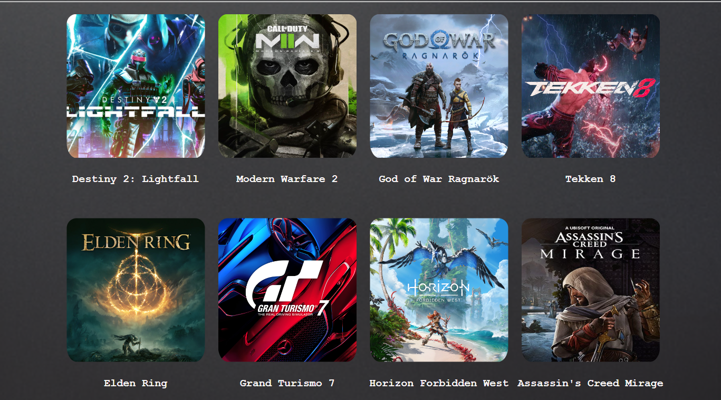
The Catalog
Lines of Code: 19
Burndown: 15%
Issues with running Riki
Intro
1
Catalog
2 3
User Forms
4
Accounts
5
Voting
6
Marketing
7
Overall
8

Slide 3
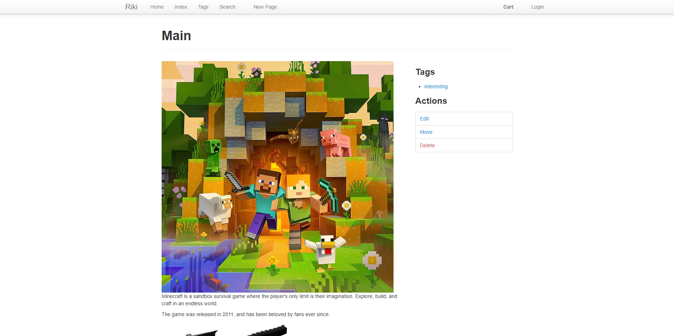
Individual Games
Lines of Code: 34
Burndown: 10%
Issues with running Riki
Intro
1
Catalog
2 3
User Forms
4
Accounts
5
Voting
6
Marketing
7
Overall
8

Slide 4
User Forms
No Update
Burndown: 0%
Issues with running Riki
Intro
1
Catalog
2 3
User Forms
4
Accounts
5
Voting
6
Marketing
7
Overall
8

Slide 5
User Accounts
No Update
Burndown: 0%
Intro
1
Catalog
2 3
User Forms
4
Accounts
5
Voting
6
Marketing
7
Overall
8

Slide 6
Community Voting
No Update
Burndown: 0%
Issues with running Riki
Intro
1
Catalog
2 3
User Forms
4
Accounts
5
Voting
6
Marketing
7
Overall
8

Slide 7
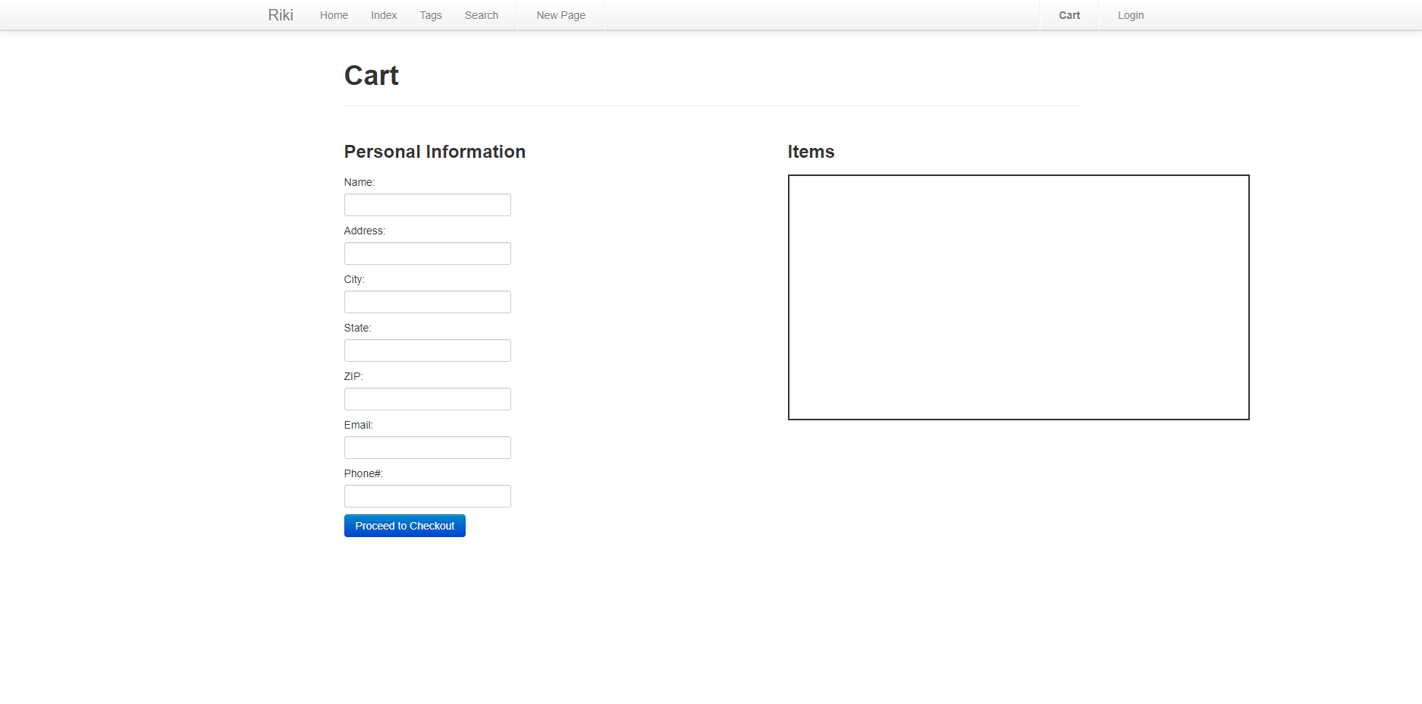
Marketing
Lines of Code: 83
Burndown: 20%
Intro
1
Catalog
2 3
User Forms
4
Accounts
5
Voting
6
Marketing
7
Overall
8

Slide 8
Overall
Lines of Code: 136
Burndown: 10%
Milestone 2
Date: 3/31/2024
Goal: Finish creation/clean up of individual features, start implementing features together.
Issues with running Riki
Intro
1
Catalog
2 3
User Forms
4
Accounts
5
Voting
6
Marketing
7
Overall
8

